Slide 1
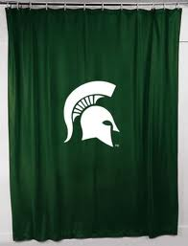
How to set up a studio

Slide 2

You will need the following:

Slide 3
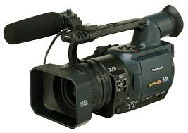
HD Camera

Slide 4
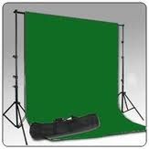
Green screen

Slide 5
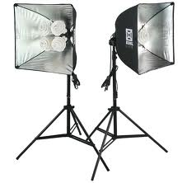
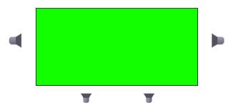
Proper Lighting
Position the lights correctly
At least 2 lights

Slide 6
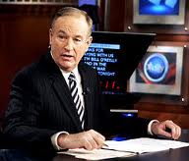
Proper clothing
Make sure that you are not wearing green or blue.
Don’t be sloppy. Wear nice, clean, clothes.

Slide 7
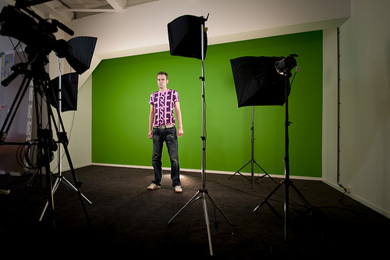
It should end up looking something like this:
Green screen
Lights
Camera

Slide 8
Now that you are finished with studio. it’s time for editing!

